Slide 1


INVESTIGATING OVER-QUANTIZATION EFFECTS IN DIGITAL IMAGES
SIMATS ENGINEERING
SAVEETHA INSTITUTE OF MEDICAL AND TECHNICAL SCIENCES
Technical presentation
ITA0506_SLOT D_COMPUTER VISION
Guided By
Dr Jeni Gracia
PRESENTED BY:
K. Manoj Kumar(192472395)

Slide 2
Introduction
What is Quantization?
Quantization converts continuous pixel values into a limited number of discrete levels.
Reducing the number of intensity (gray or color) levels in an image to make it easier to store, process, or transmit.
What is Over-Quantization?
Over-quantization occurs when an image is reduced to very few intensity or color levels, causing noticeable degradation.
Excessive reduction of intensity levels.
Leads to noticeable loss of image quality.
Effects of Over-Quantization
Loss of fine image details.
Color banding (visible color/intensity steps).
Reduced contrast and sharpness.
Distorted edges and textures.
Visual artifacts appear in the image.

Slide 3
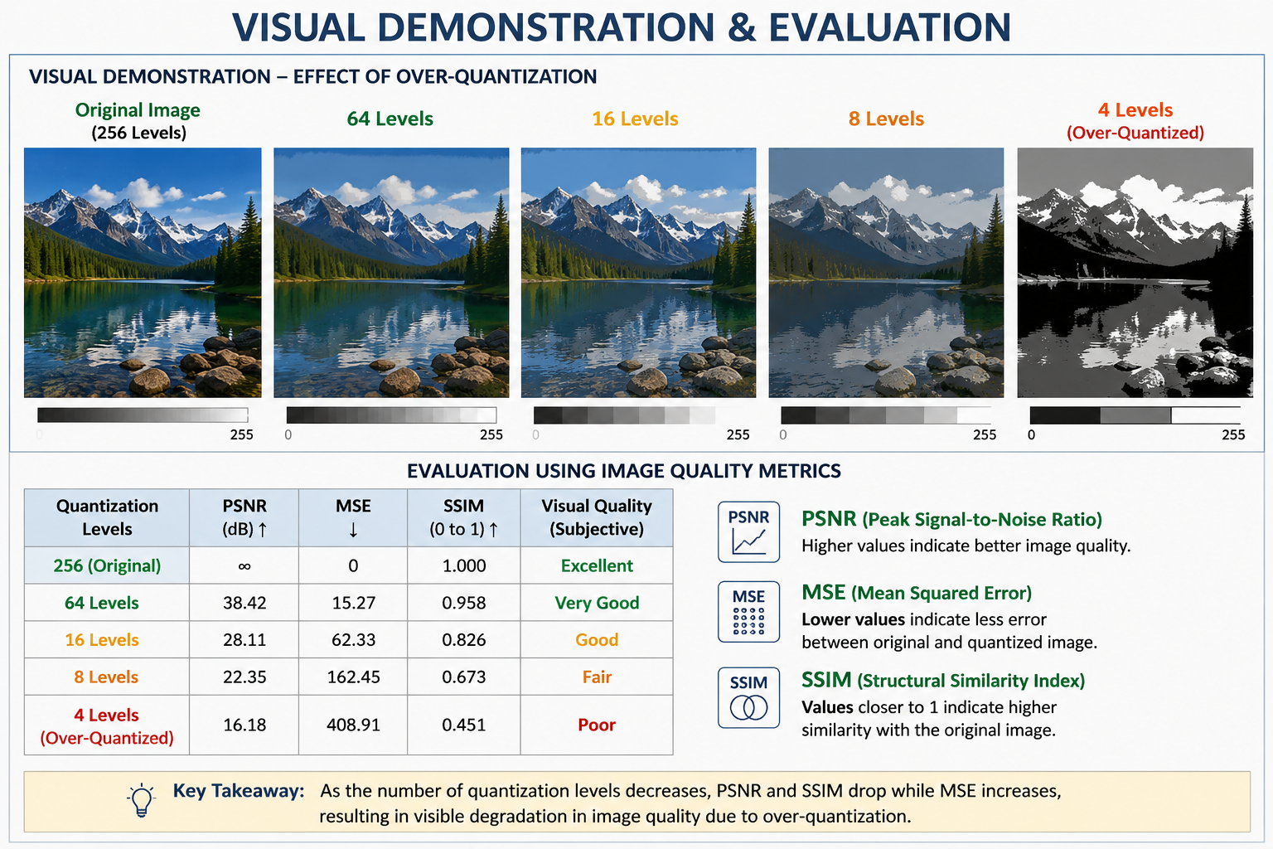
Visual Demonstration & Evaluation
Visual Comparison
Original Image
64-Level Quantized Image
16-Level Quantized Image
4-Level Quantized Image
Compare the original image with quantized images at 256, 64, 16, and 4 intensity levels.
Observe the gradual reduction in image quality as quantization levels decrease.
Identify color banding, loss of details, and blurred edges in over-quantized images.

Slide 4
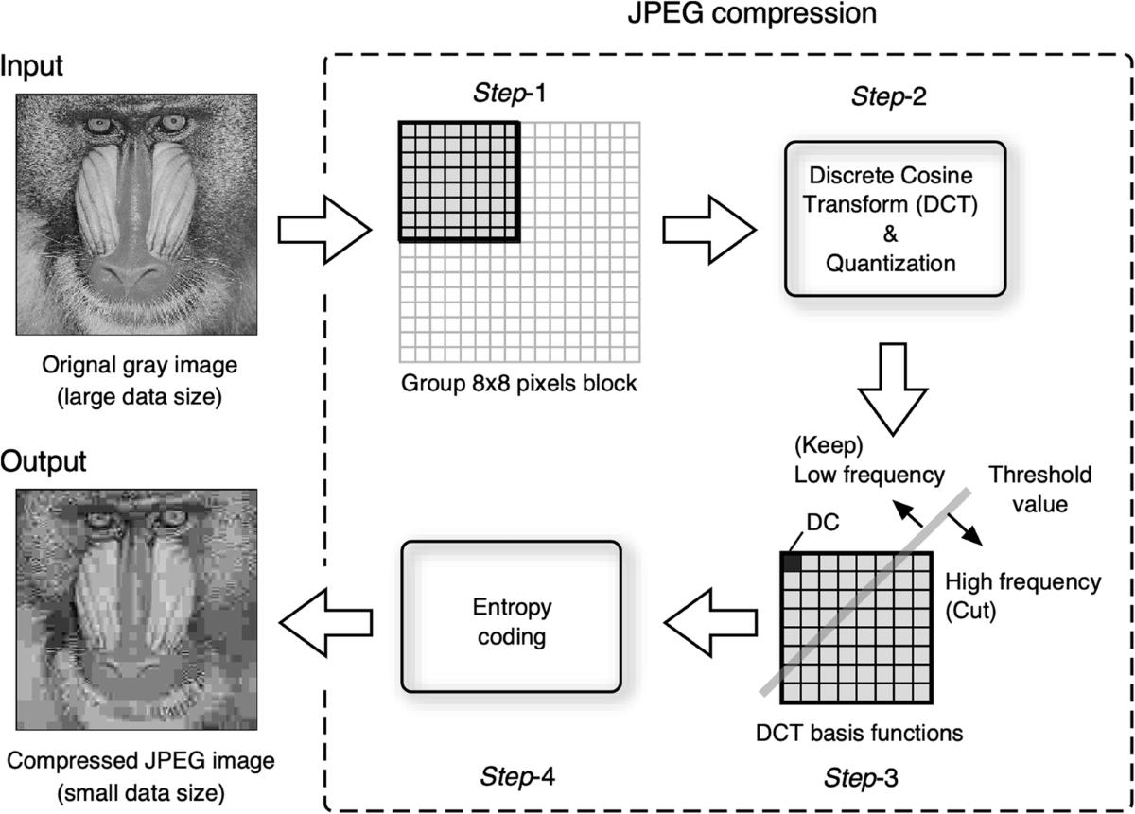
Applications of Quantization
Image Compression – Reduces image file size for efficient storage and transmission.
Medical Imaging – Used in X-rays, MRI, and CT scans to process and store images.
Satellite Imaging – Compresses large remote sensing images for faster analysis.
Computer Vision & AI – Helps optimize image processing and deep learning models.
Multimedia Systems – Used in digital cameras, video streaming, and image editing software.

Slide 5
LIMITATIONS
Permanent loss of image information.
Lower accuracy in image analysis and object detection.
Poor quality for medical and satellite imaging.
Difficult to recover the original image.
Not suitable when high visual quality is required.
Excessive compression reduces user experience.

Slide 6
Conclusion
Quantization helps reduce storage and transmission costs.
Over-quantization significantly reduces image quality.
Visual demonstrations clearly show detail loss and color banding.
A balance between compression and image quality is essential.
Future Scope
Use adaptive or AI-based quantization techniques.
Optimize compression while preserving image quality.

